Slide 1
Perspectives on Information Models
J. Marc Overhage, MD, PhD
VP and Chief Medical Informatics Officer

Slide 2
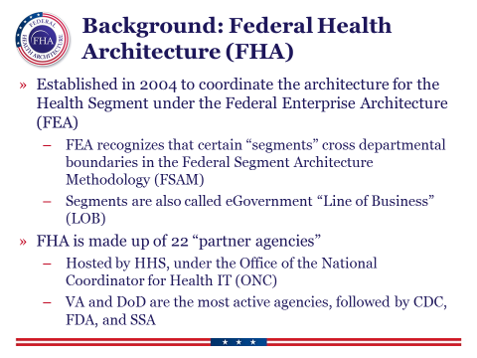
Transactional Systems
Model foundations laid in early 90’s
Models evolved to support transactional/Operational needs
Bunge cords
Variation across implementations
Model Experience
Standards based

Slide 3

Continuously advancing toward your goals
Model Experience
Recommendations
Value
Continuous Advancement
Optimization
Status quo
Time
Notes:
So why is Model Experience so important now? It’s in part because we are in a new era. In broad terms, the era we all operate in defines the strategy to health care IT. To put it simply, in the last thirty or so years we’ve collectively progressed through two major eras and entered a third.
[click to show to “status quo”]
First, there was the activation and maintenance of systems. You and your peers received the value inherent in moving from paper-based processes to digitized and automated processes. After implementation, many health systems simply maintained their solutions or made minor improvements.
[click to show “recommendations” line]
Of course, learning and advancing recommendations never rest. The state-of-the-art always marches forward.
[click to show “optimization”]
In the next era, many health systems optimized or uplifted their EHRs. For some that meant switching platforms altogether. A lot of this was driven by new regulatory requirements but certainly other forces as well. Optimization or uplifting was a tactic to achieve a goal, oftentimes a goal set by regulators.
[click to show “continuous advancement”]
Which brings us to today. Nearly every health system is past digitization, automation and most technical regulatory requirements. You use CPOE; you hear the beeping of bar code scans all day every day; your portals are live; you send lots of reports to government agencies; you are plugged into HIEs; your devices and systems talk to each other; and so forth. In this new era, performance or value is the key driver – the next frontier to conquer. The gaps between your current IT and recommendations are substantially more important to close with every bit of value you can extract with the technology investments you’ve made. Because closing them can directly enhance performance in areas like quality, safety, satisfaction and finances. In fact, those four areas have never been more closely connected. The Model Experience is Cerner’s solution strategy recommendations to help you increase value.
[click to show green rectangle and “Model Experience”]
It’s also more than a model system. Yes, it contains thousands of recommendations, but the Model Experience is also an approach and culture of continuous advancement to keep your Cerner solutions optimized, to keep pace with recommendations and continue to help increase performance in those four areas – quality, safety, satisfaction and financial performance.
A couple minutes ago I said the new era is part of the reason why the Model Experience is so important and important now. The other part is this. Cerner’s mission is to contribute to the systemic improvement of health care delivery and the health of populations. This is our best advice on how we can collaborate to fulfill that mission.
[Suggested question/s for your audience]
Which of these three approaches do you think best describes your approach to health care IT? Status quo, occasional optimization, or continuous advancement?
Which of these approaches is best-suited to helping your organization achieve its goals?

Slide 4
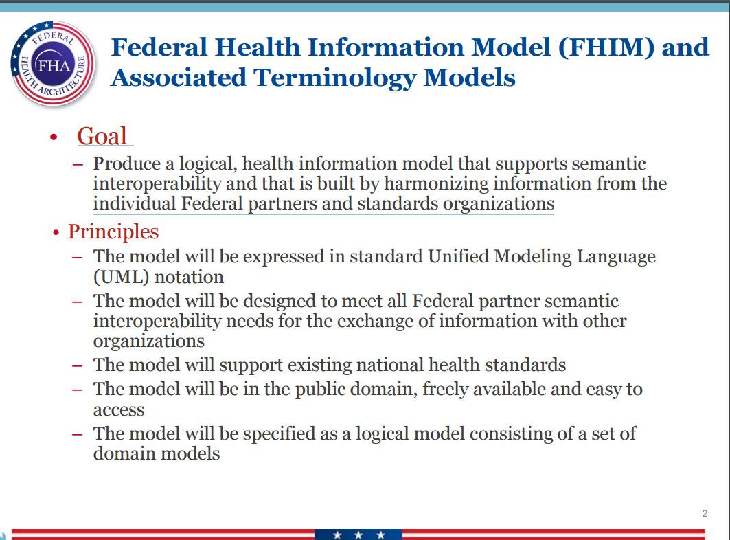
Population Health – another at bat?
Drivers
Interoperability/Longitudinal Record
Clinical decision support
Analytics
Information Model
FHIR inspired

Slide 5
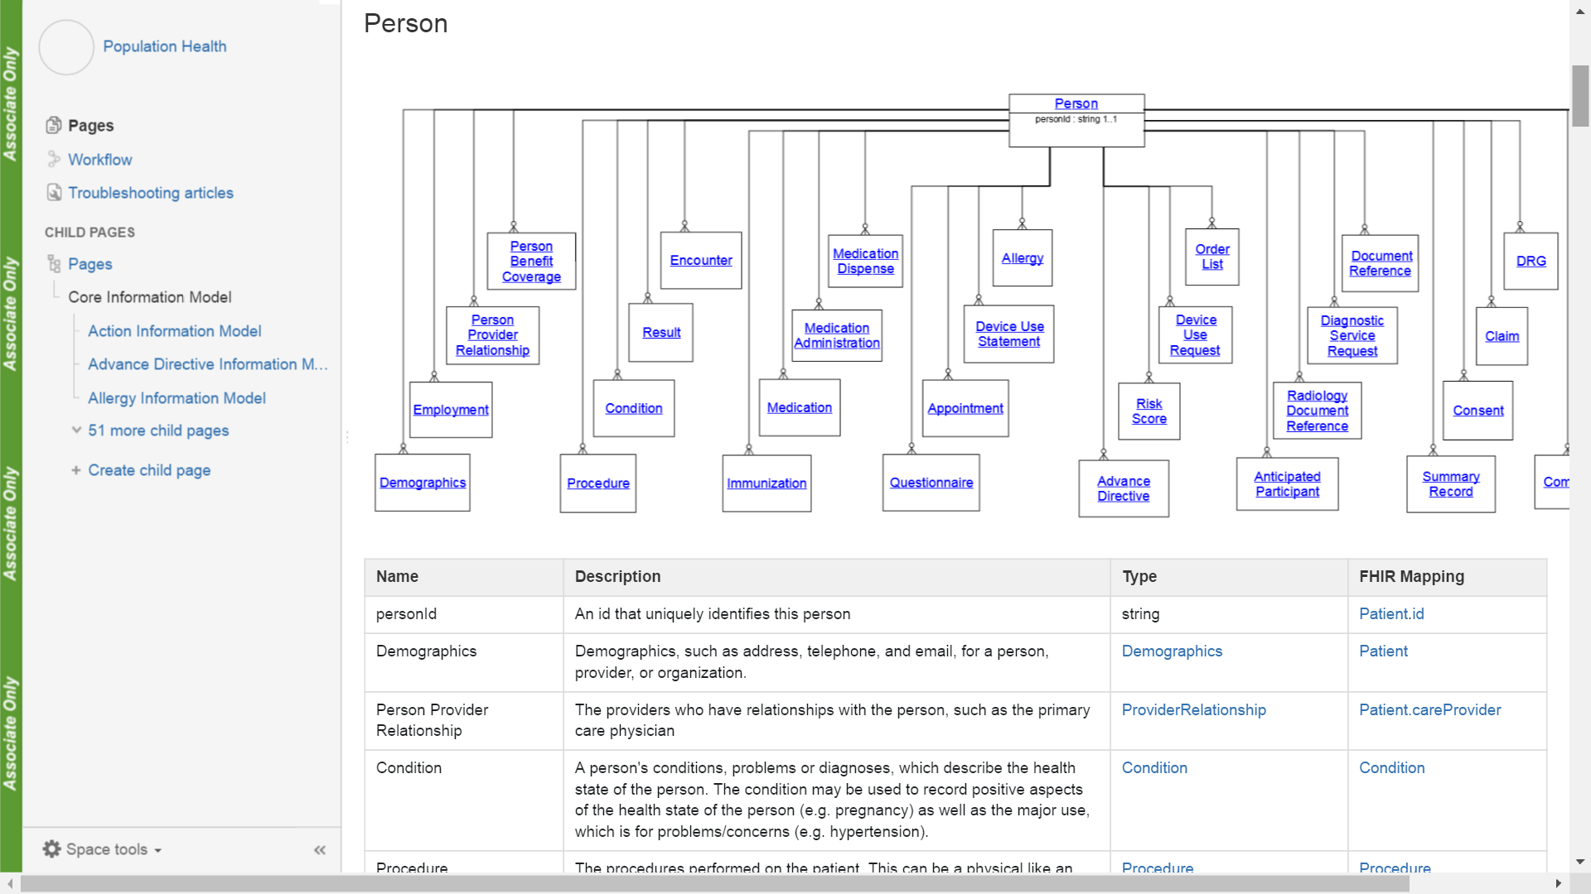
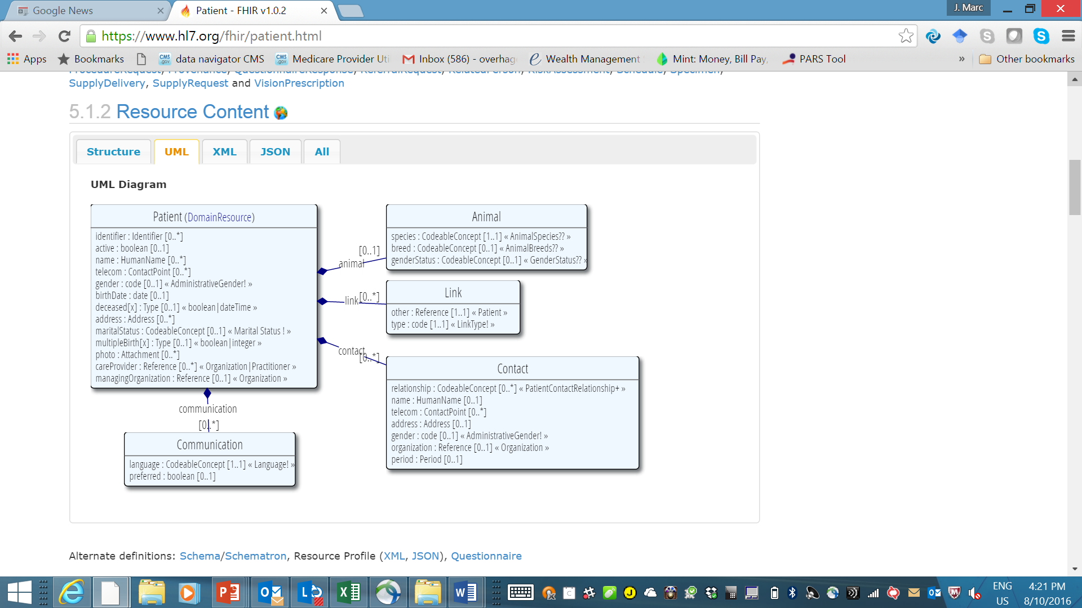

Slide 6
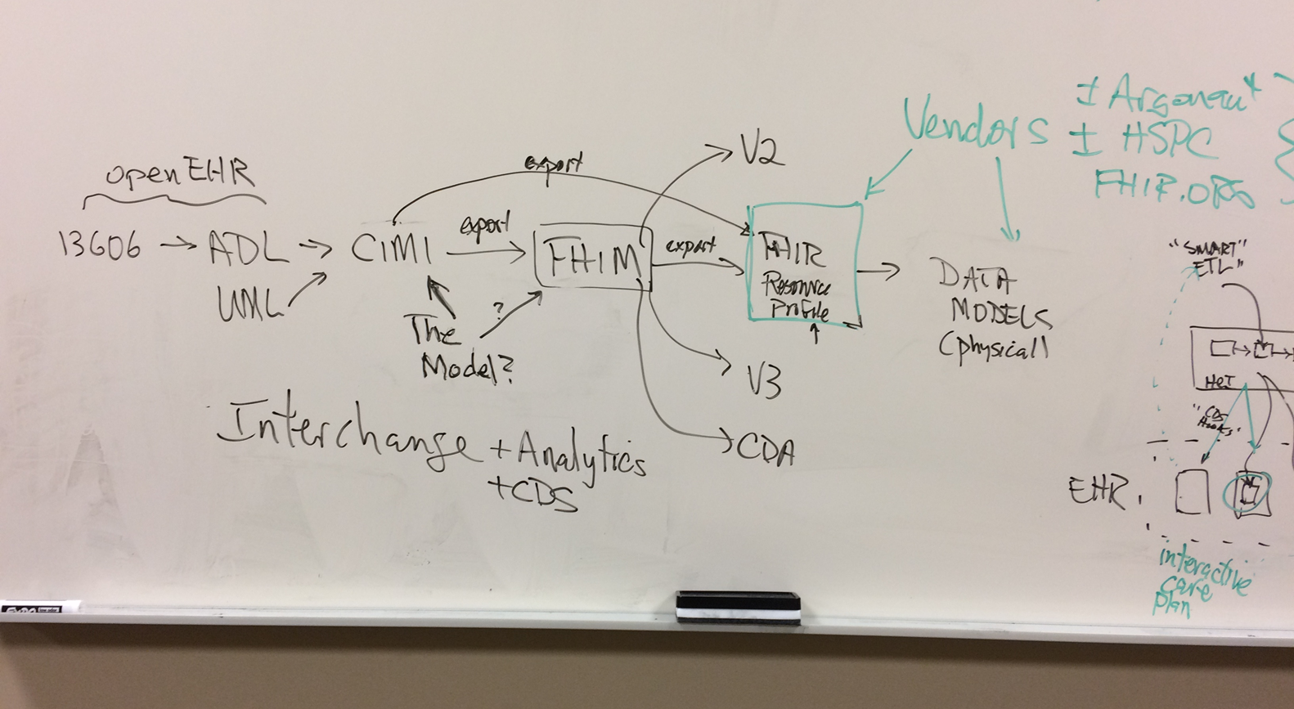
Thoughts moving forward
Consider the role of Enterprise Content/Knowledge Management
Pragmatism
e.g. DTSU as informed by the Argonaut project
Art of the possible

